Slide 1
PRAGMA-GLEON Expedition (GRAPLE) - Lake Science on Overlay-networked Resources
Paul Hanson (University of Wisconsin)
Cayelan Carey (Virginia Tech)
Renato Figueiredo, Ken Subratie (University of Florida)

Slide 2
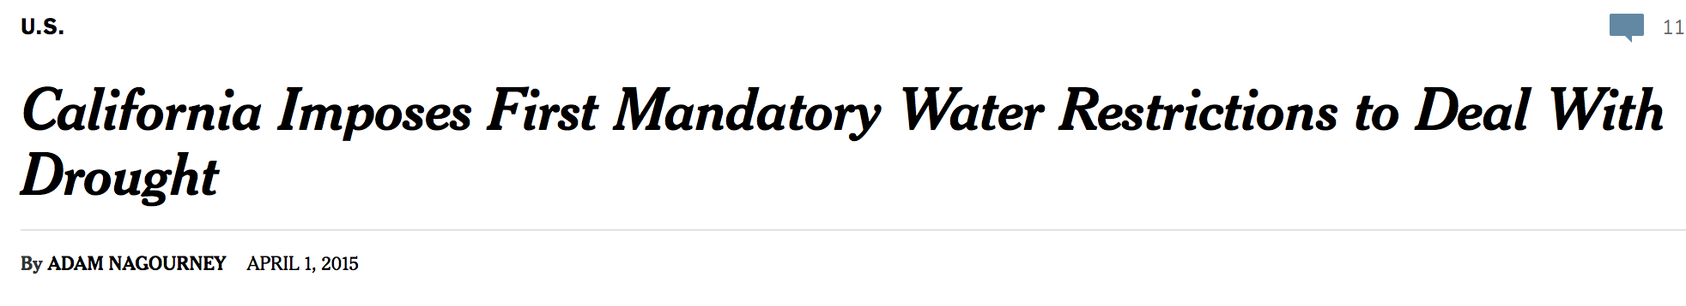
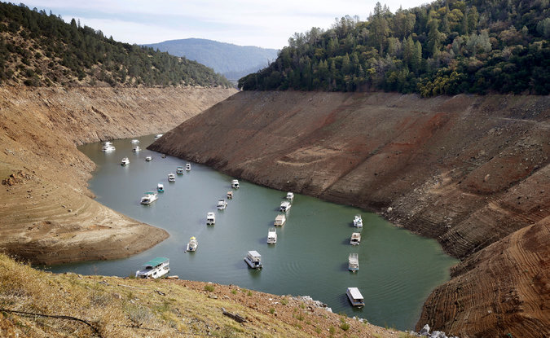
Oroville Lake
Rich Pedroncelli
Notes:
NYT cover on 1 April

Slide 3
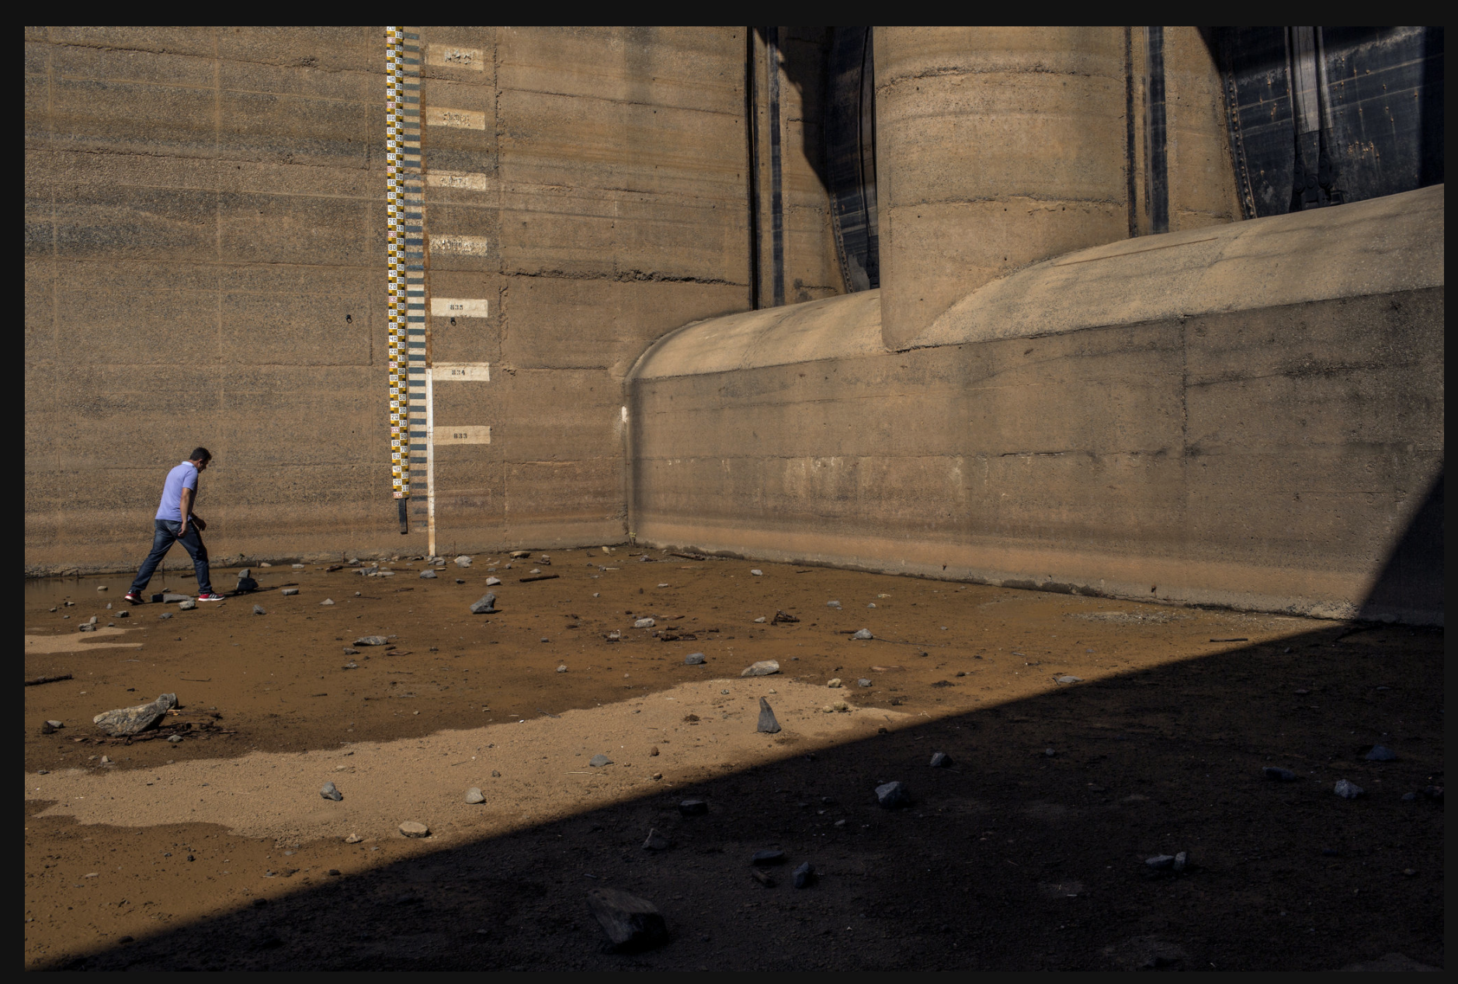
Sao Paulo’s main drinking water reservoir. Photo: Mauricio Lima

Slide 4
We are facing an unprecedented global water crisis
Across the world, climate change and other human activities are threatening freshwater quality and quantity
These stressors will likely only increase in the future, especially for lakes and reservoirs, our primary drinking water sources
Ultimately, we need to better manage lake water quality to best leverage the water resources we do have access to

Slide 5
The implications are profound…

Slide 6
…And will affect all of us.
Undrinkable water due to contaminants, pharmaceuticals, heavy metals, and more
Toxic algal blooms
Fish kills
Loss of recreation
Long-term health effects
Altered food prices and economies
Water refugees and conflict

Slide 7
Ultimately, we need to understand how lake water quality will respond to human demands and changing climate.

Slide 8

Addressing these problems in a globally significant way requires use of distributed resources: data, models, people, compute
+
GLEON

Slide 9
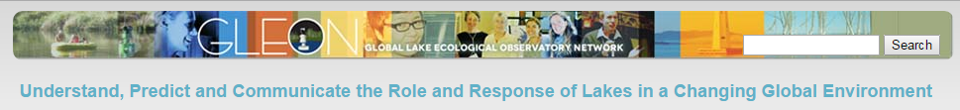
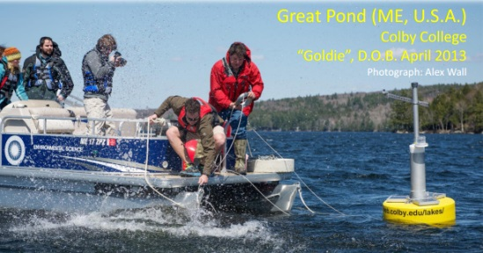
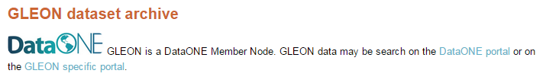
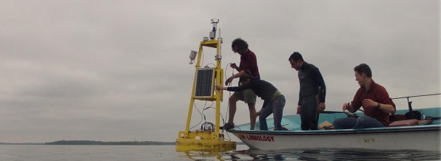
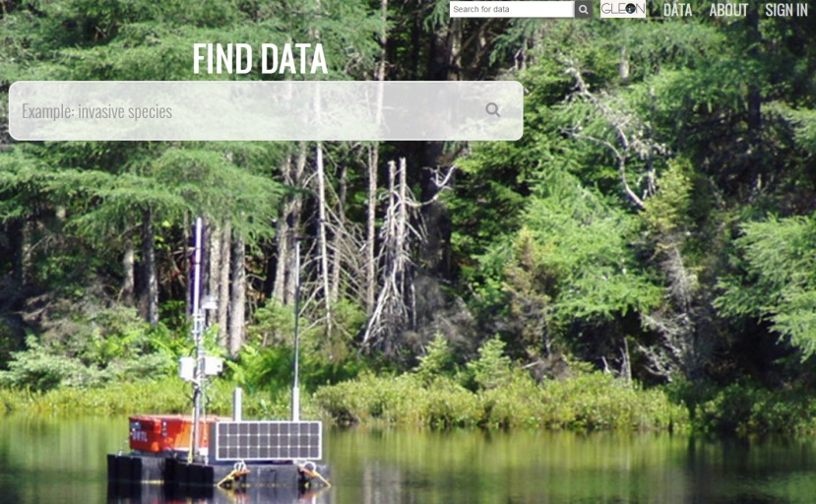
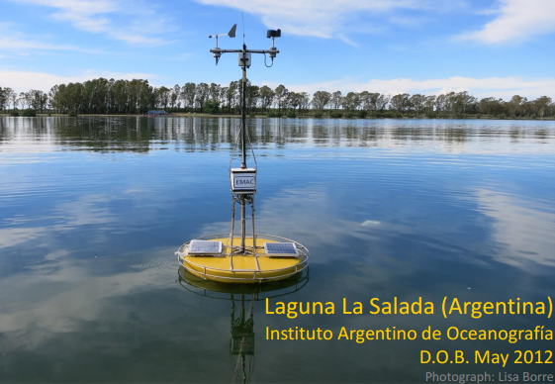
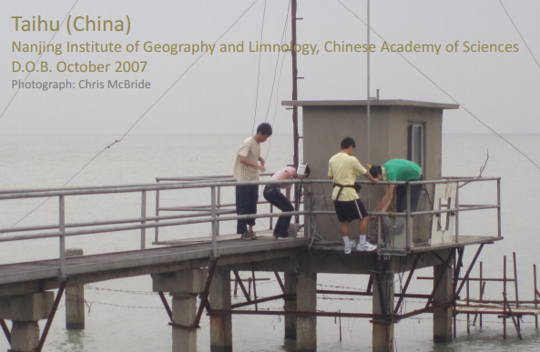
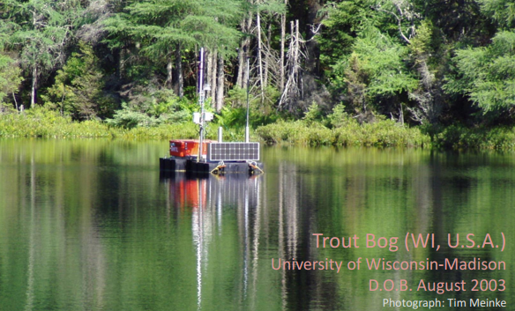
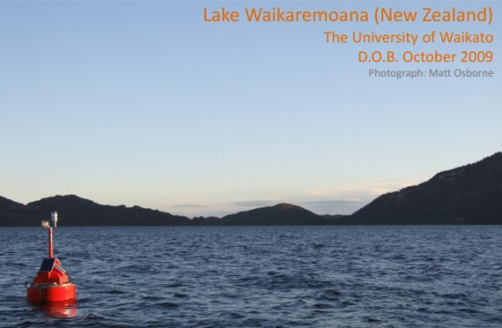
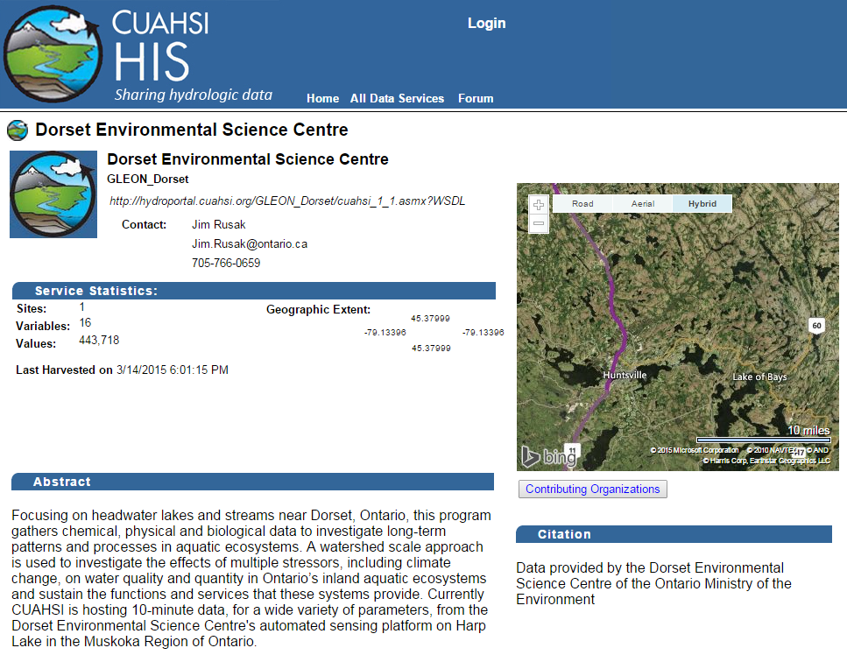
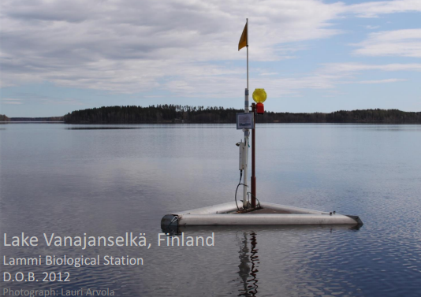
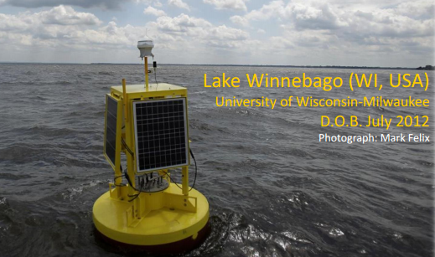
Data
Notes:
Sensor networks are revealing new dynamics that were previously unknown- and are rapidly changing our understanding of lake blooms

Slide 10
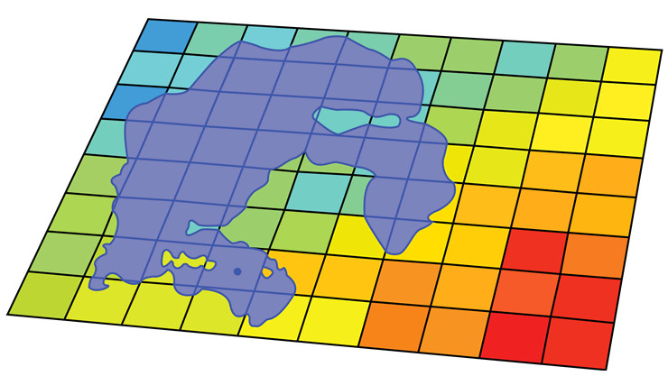


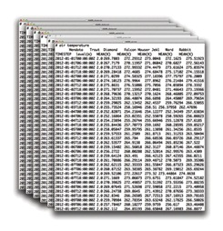
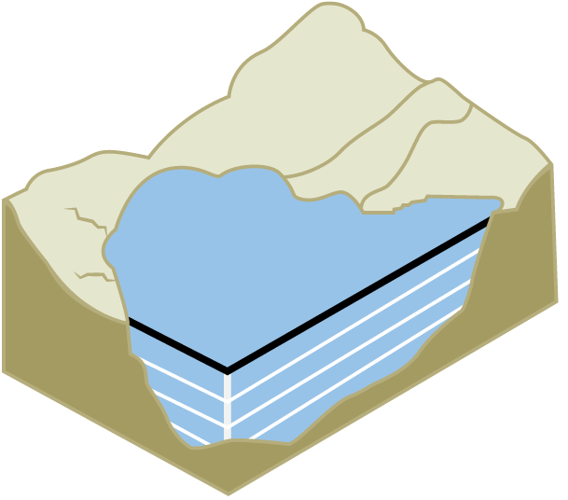
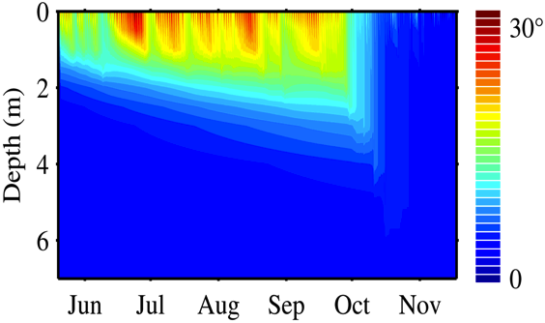
Simulating lakes in the landscape
Models
NHD lake feature
Parameterization of models with gridded data
Dynamic lake temperature simulations
Parallel computing with
Gridded data
General Lake Model: U of W AUS
(Read et al. 2014)
Notes:
This process X 2,400 lakes. Modeling of lakes takes 1~5 minutes per lake for 33 years.
Open source R!!
Parallel computing!
The parameterization was generic for these lakes, so our results were not influenced by any lake-specific tuning.

Slide 11
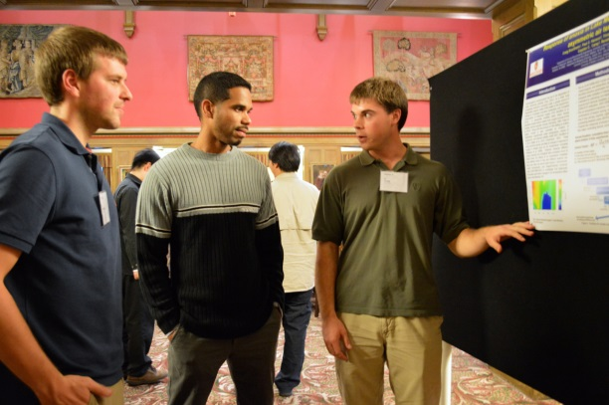
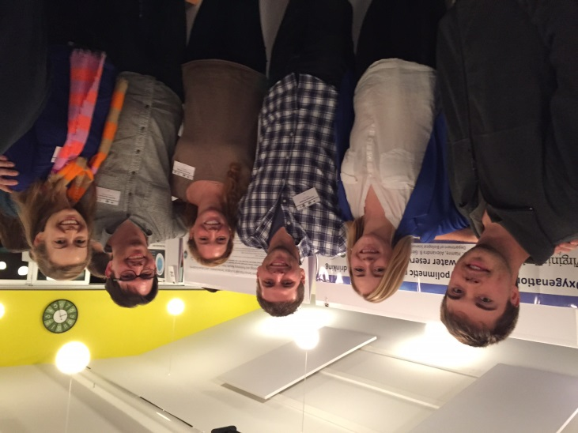
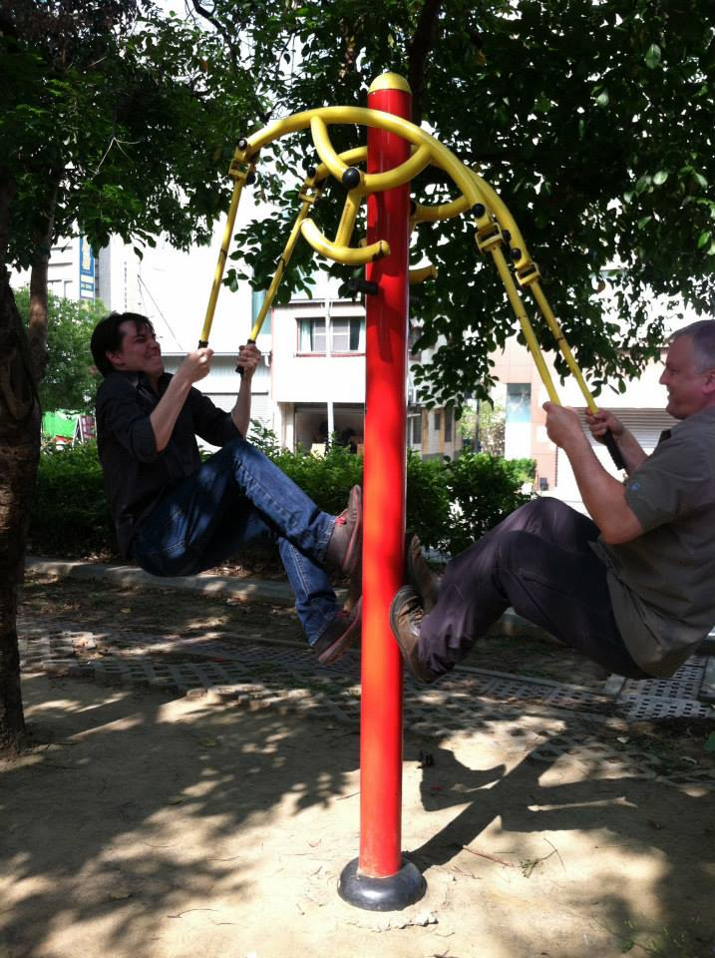
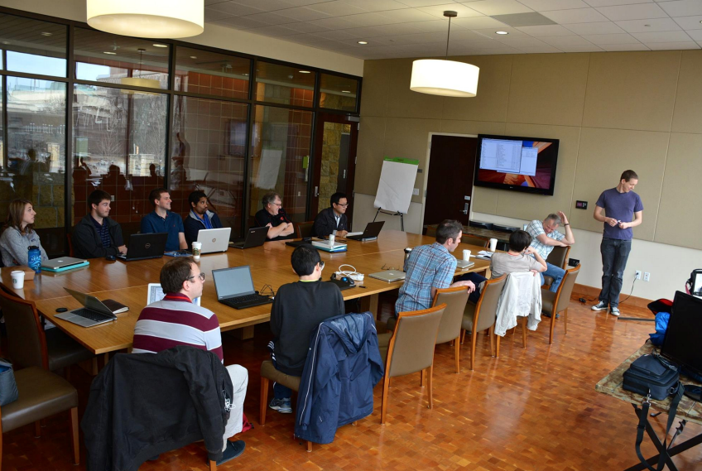
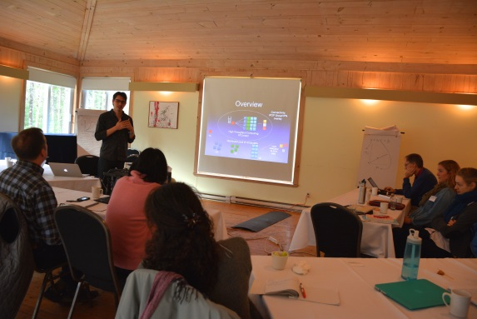
Inter-disciplinary activities
PRAGMA’26, ’27, ‘28
does PRAGMA run on a Mac?
GLEON’16 workshop
cyanobacteria = blue-green algae?
IP over… P?
GLM Week
We want more computers! And save the world!

Slide 12
Meta-Goals
Exploit lake sensor network observations (GLEON) with overlay network technology (PRAGMA) to expand our modeling capacity =(GRAPLE)
GRAPLE = GLEON Research And PRAGMA Lake Expedition: integrating disparate technology, knowledge, and researchers to advance lake science
Our ultimate long-term goal: expand the lake expedition to include cohorts of graduate and undergraduate students through targeted training in both computer science and limnology

Slide 13
Technology
Middleware: we need an architecture that is poised for growth: flexible, general-purpose, scalable
Application: we need to support applications poised for growth in the community
Technical approach
IPOP: overlay network aggregates distributed resources – servers, desktops, cloud
HTCondor: manages jobs across resources
GRAPLE scripts: application-specific code, exposing familiar computer environments, emphasis on ease of use for GLM-FABM jobs

Slide 14
IP-over-P2P (IPOP) Overlay
“User-Defined Networking”
SDN that users can deploy across their own resources
User-level; easy to use
Software only needed at endpoints
Cloud VMs, personal computers, mobile devices
Map social network to virtual network links
E.g. GRAPLE researchers, students
Peer-to-peer VPN links
No centralized gateway
Learn more about the open-source software:
http://ipop-project.org

Slide 15
Technology Updates
Application: GRAPLE scripts
Expose simple interface to users
Handle packaging of multiple simulations into Condor job, compression, and job submission
Middleware: IPOP enhancements
Ganglia monitoring
Switch mode, opportunities for integration with SDNs
Engagement in Google summer of code 2015
Resources: private and public clouds
UF, UW, VT: prototype cluster & desktops
Azure: successful $20k proposal; on-demand cycles

Slide 16
Demonstration - overview
A distributed HTCondor pool spanning multiple domains
Azure VM pool
UF VM pool
Cayelan’s
Desktop at VT
Hanson’s
desktop
at Uwisc
IPOP
Overlay
Ken’s laptop
GRAPLE scripts

Slide 17
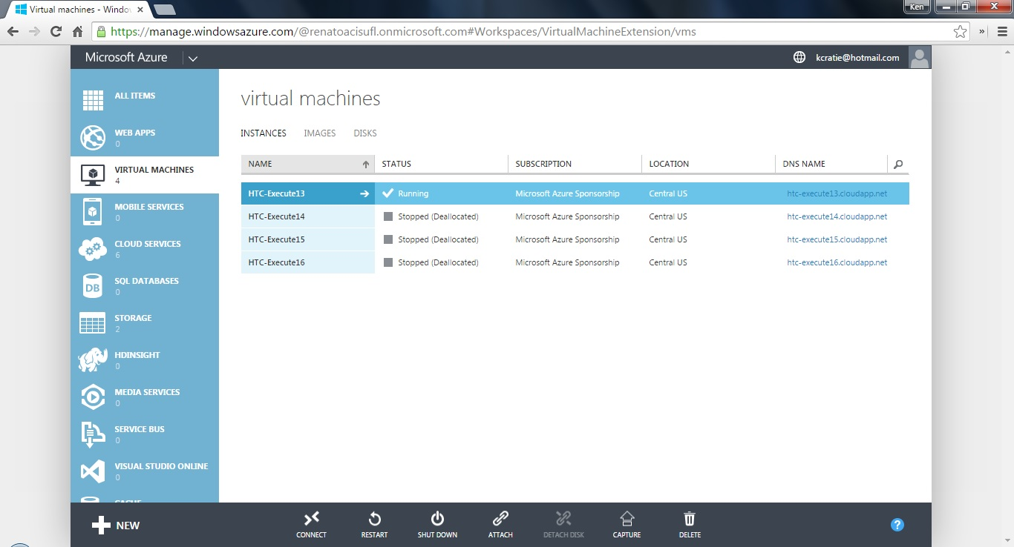
Azure VM

Slide 18
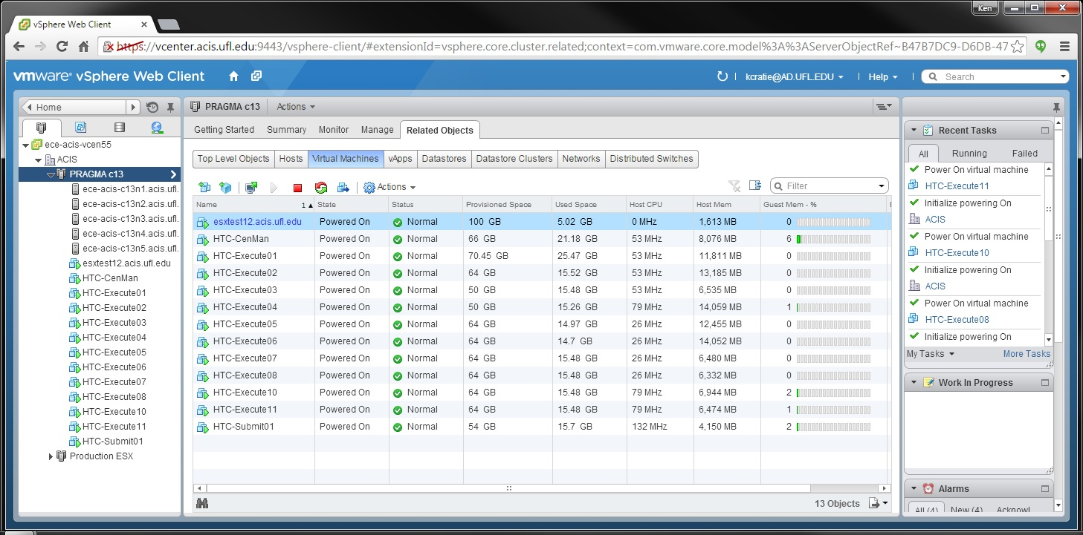
VMware ESX VMs

Slide 19
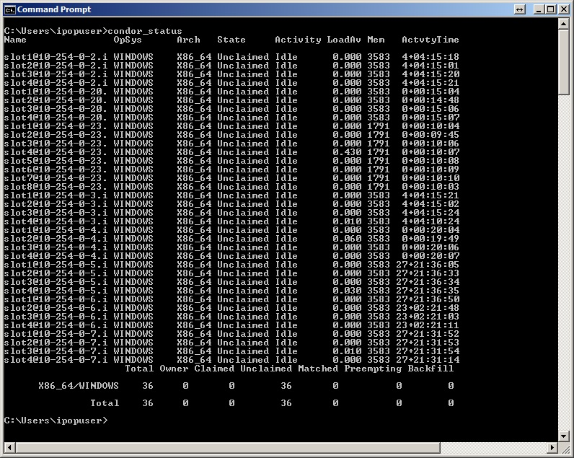
HTCondor+overlay

Slide 20
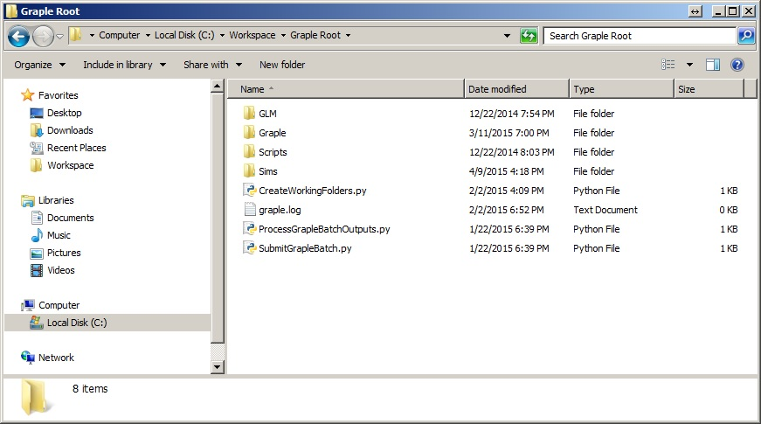
GRAPLE directories

Slide 21
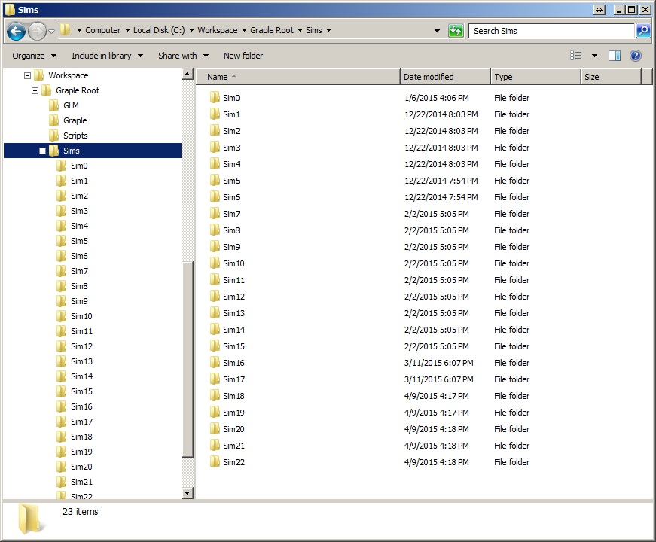
GLM simulation directories

Slide 22
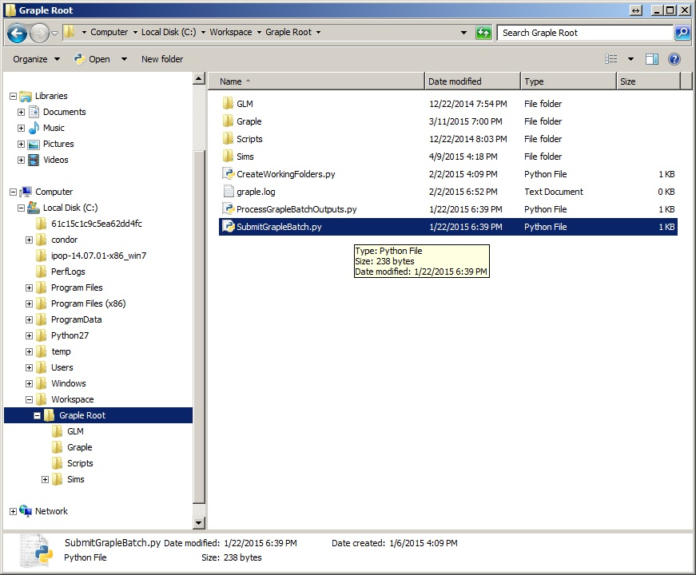
Submit jobs

Slide 23
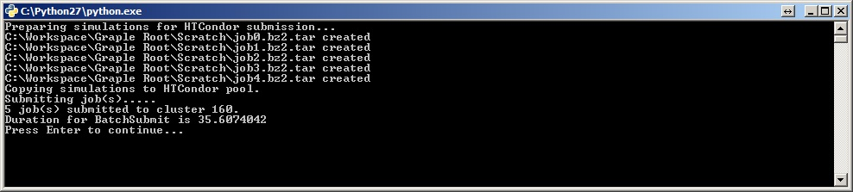
Jobs submitted

Slide 24
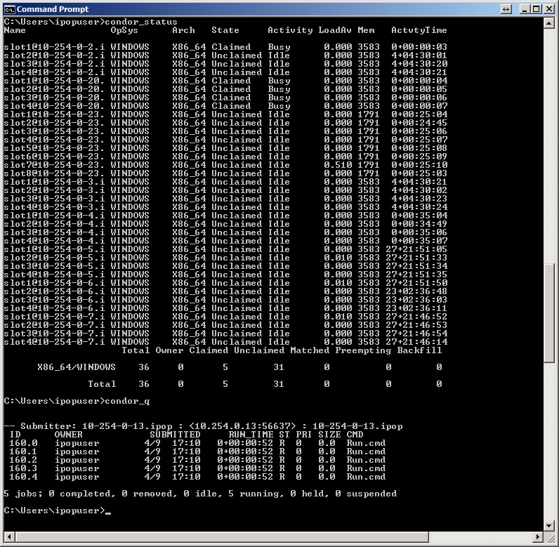
Jobs running

Slide 25
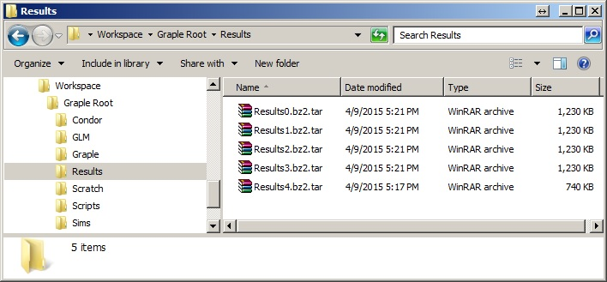
Results

Slide 26
Meta-Goals
Exploit lake sensor network observations (GLEON) with overlay network technology (PRAGMA) to expand our modeling capacity =(GRAPLE)
GRAPLE = GLEON Research And PRAGMA Lake Expedition: integrating disparate technology, knowledge, and researchers to advance lake science
Our ultimate long-term goal: expand the lake expedition to include cohorts of graduate and undergraduate students through targeted training in both computer science and limnology

Slide 27
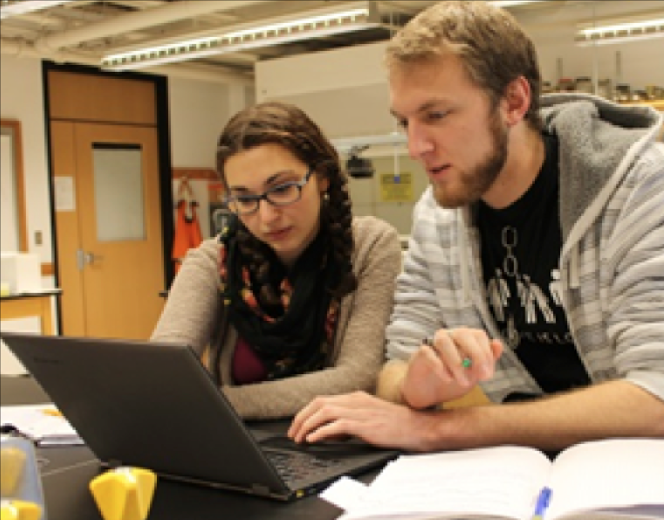
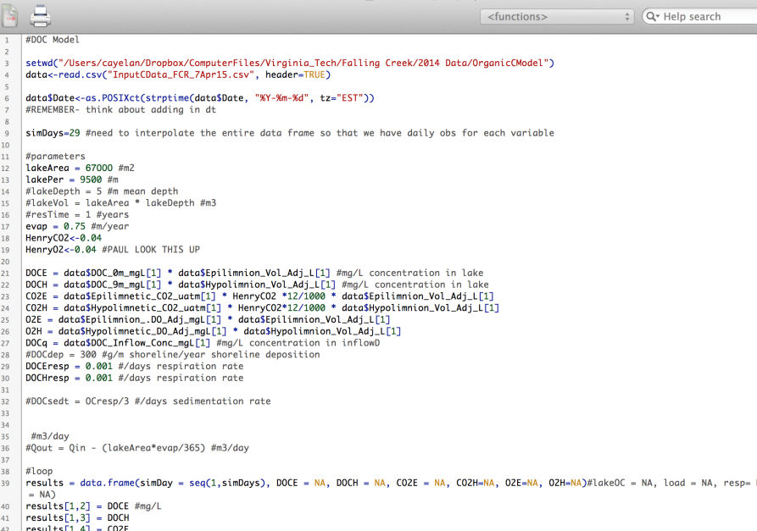
Expanding GRAPLE globally
We have developed simple GRAPLE R scripts as a teaching module to run the lake model in undergraduate and graduate classrooms
Students manipulate climate and land use scenarios and then run the lake model to study their effects in silico

Slide 28
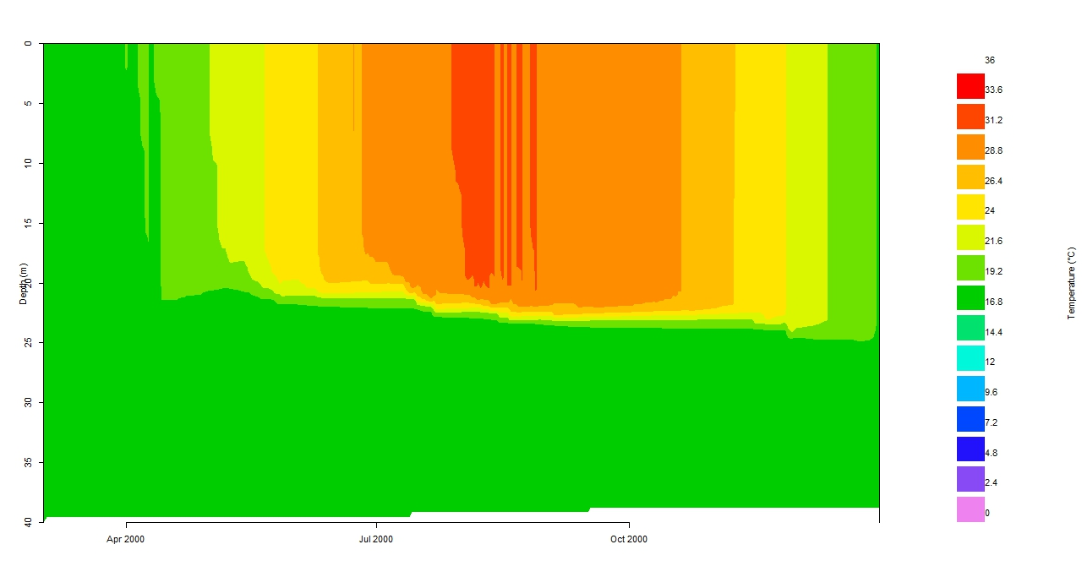
Baseline scenario: results from April 2015

Slide 29

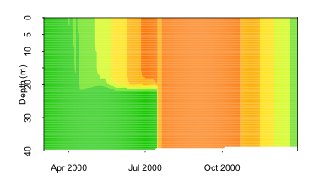
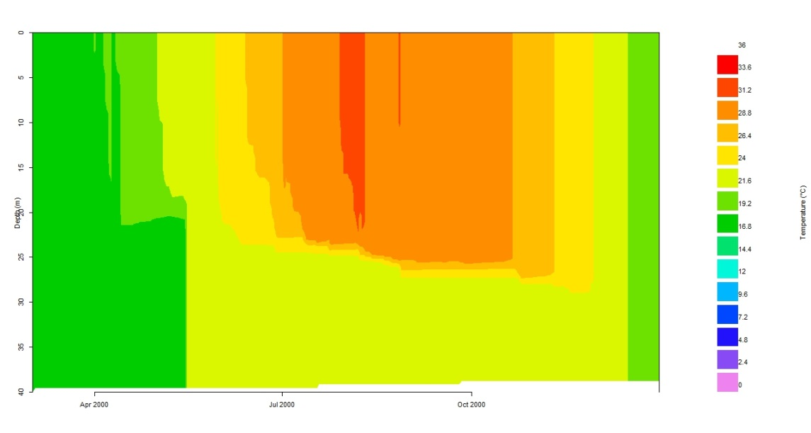
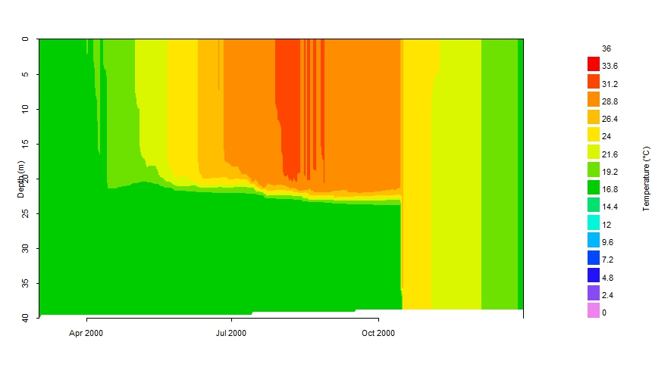
Manipulating climate in silico as a teaching tool across disciplines

Slide 30
Next steps
The first cohort of students at Virginia Tech are being formally assessed to track their responses to using GLM and overlay technology
This module will be disseminated to 8 universities for testing in the fall as part of the U.S. NSF-sponsored Project EDDIE and will be released publicly in 2016
We have partnered with pedagogical experts to study how non-CS students use this technology → will enable broad dissemination
All GRAPLE materials will be available open-source for GLEONites and students to access

Slide 31
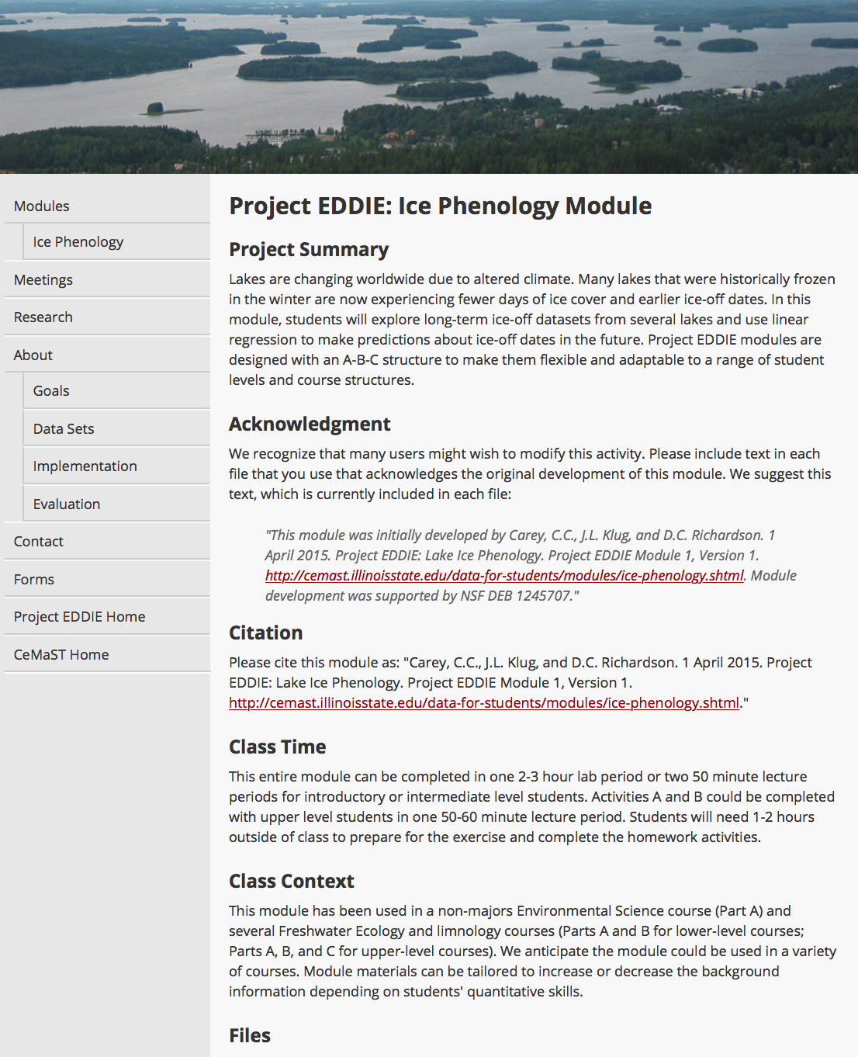

projectEDDIE.org

Slide 32
Expanding GRAPLE beyond this initial expedition
Our work to date has demonstrated that CS-limnology synergies can provide new tools for tackling local to global water issues
We are poised to lead a new wave of technology-enabled, multi-disciplinary research that will transform the science we can accomplish
Make distributed computing accessible to domain scientists by simplifying the steps needed to participate in the overlay network
We have identified two GLEON working groups that will be trained through these scripts to enable their research
Grow the next generation of users by training students how to use GLM & overlay networks by teaching these scripts in classrooms worldwide
Notes:
We are revolutionizing how you create a community of users, as well as the science that we are able to enable.

Slide 33
Acknowledgments
GRAPLE students
Craig Snortheim, Jon Doubek, Alex Gerling, Kate Hamre, Ken Subratie, Youna Jung
IPOP developers
Ken Subratie, Kyuho Jeong, Saumitra Aditya
This material is based upon work supported by the National Science Foundation under Grants No. 1234983 and 1339737

